Slide 1
There are currently two popular and feasible solutions:
Physical sever & GPU, directly running the AI ​​model (LLM3.1 8B); VMware & direct GPU to virtual machine. What we currently know and can do.
2.Solution:
2.1 Physical machine & GPU (MR100), install the MR100 driver, install Docker, import the container Corex provided by the manufacturer, upload the model to the container, and run it.
2.2 Vmware&GPU, pass the GPU directly to the virtual machine, install the MR100 driver, install Python 3.10, install the VLLM framework, and upload the model to the virtual machine CentOS/Untube.
We are familiar with the underlying construction, but not expert in the program. We need your programmers for optimization and management.
We are not familiar with the VGPU solution. It only has pass-through. Even through Vmware, it is pass-through.
Moreover, this method is complex to implement and is not suitable for the operation of AI models.

Slide 2
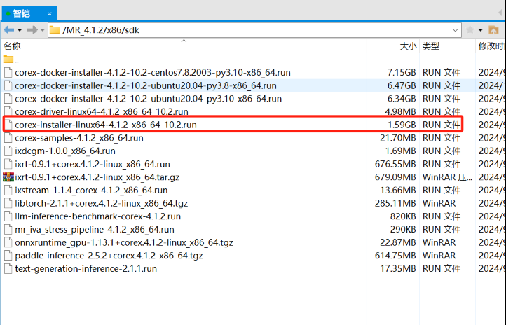
Configuration method 1 physical machine+MR100+centos7.9+Run ai module
Install packet :
sudo yum update
sudo yum group install "Development Tools"
sudo yum install kernel-devel
sudo yum -y install epel-release
sudo yum -y install dkms
Docker install :
Yum install docker-ce docker-compose–y
MR100-GPU driver installation:
[root@localhost ~]# chmod +x corex-installer-linux64-4.1.2_x86_64_10.2.run
[root@localhost ~]# ./corex-installer-linux64-4.1.2_x86_64_10.2.run
vi /root/.bashrc
export LD_LIBRARY_PATH=/usr/local/corex-4.1.2/lib
export PATH=/usr/local/corex-4.1.2/bin:$PATH
source /root/.bashrc

Slide 3
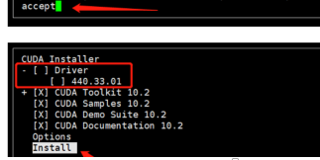
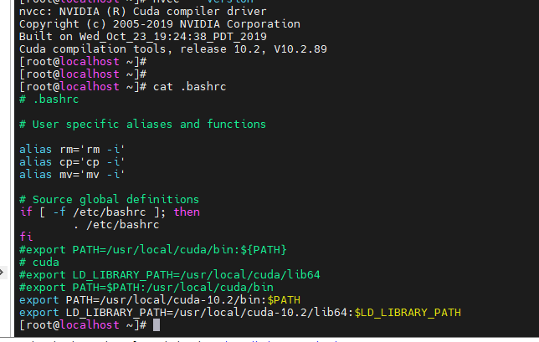
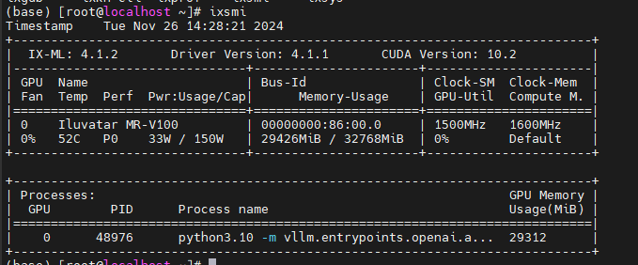
Configuration method 1 physical machine+MR100+centos7.9+Run ai module
CUDA install :
chmod +x cuda.run
[root@localhost ~]# ./cuda.run
export PATH=/usr/local/cuda-10.2/bin:$PATH
export LD_LIBRARY_PATH=/usr/local/cuda-10.2/lib64:$LD_LIBRARY_PATH

Slide 4
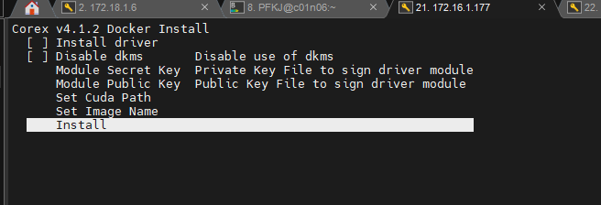
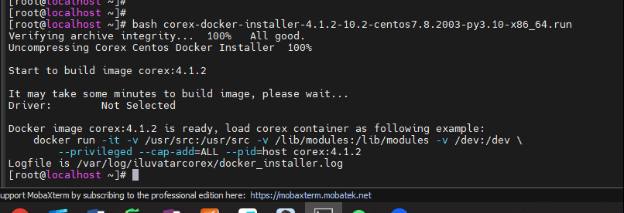
Configuration method 1 physical machine+MR100+centos7.9+Run ai module
Docker image load :
bash corex-docker-installer-4.1.2-10.2-centos7.8.2003-py3.10-x86_64.run

Slide 5
Configuration method 1 physical machine+MR100+centos7.9+Run ai module
The container integrates the vllm environment
Pip list
torch 2.1.1+corex.4.1.2
torch_cluster 1.6.0+corex.4.1.2
torch_quiver 0.1.0+corex.4.1.2
torch_scatter 2.1.0+corex.4.1.2
torch_sparse 0.6.16+corex.4.1.2
torchaudio 2.1.0+corex.4.1.2
torchdebug 0.1.0+corex.4.1.2
torchvision 0.16.0+corex.4.1.2
tornado 6.4.1
tox 4.18.0
uvicorn 0.30.6
uvloop 0.20.0
virtualenv 20.26.3
vllm 0.5.0+corex.4.1.2
wrapt 1.14.1
xentropy_cuda_lib 0.1+corex.4.1.2
xformers 0.0.22+corex.4.1.2
xxhash 3.5.0

Slide 6
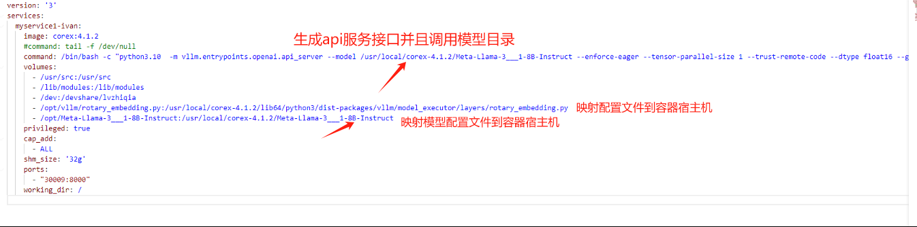
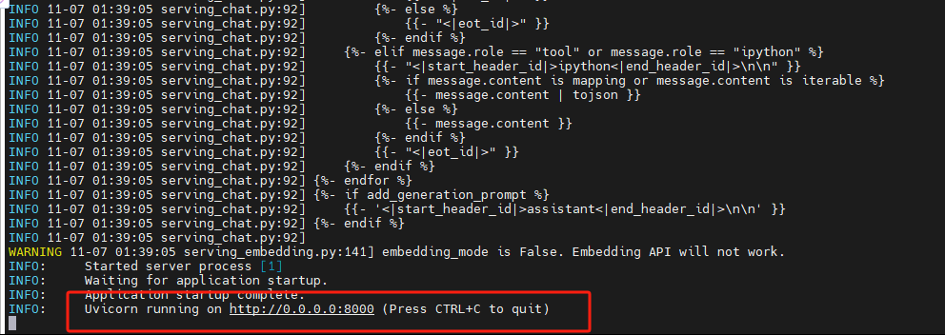
Configuration method 1 physical machine+MR100+centos7.9+Run ai module
Run the model to generate the API interface

Slide 7
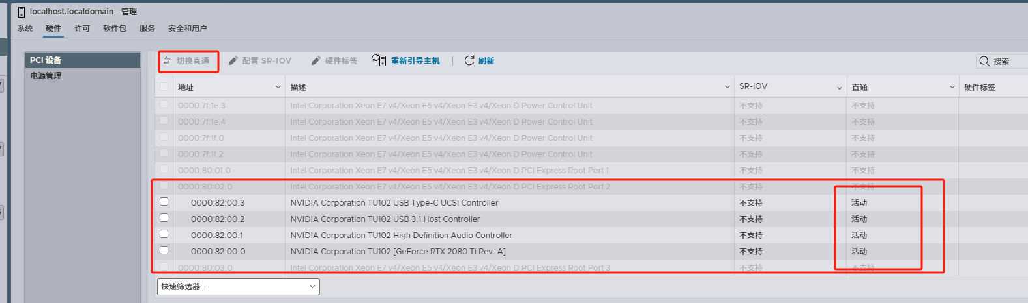
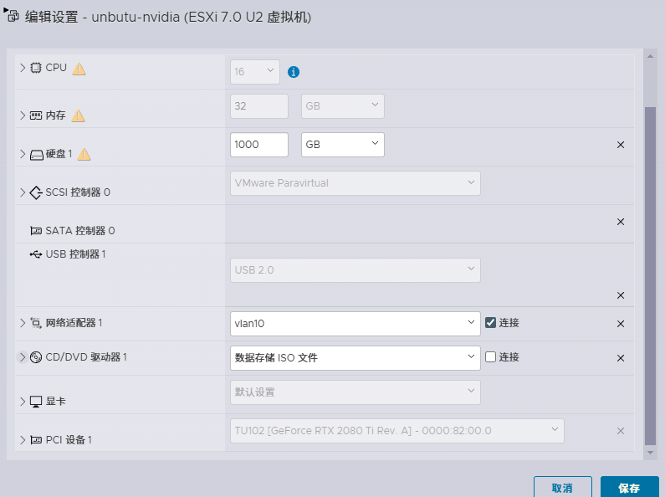
Configuration method 2 vmware esxi Pass-through GPU + unbutu +Run ai module

Slide 8
Configuration method 2 vmware esxi Pass-through GPU + unbutu +Run ai module
Step 1: Configure the Ubuntu 24.04 Virtual Machine
Configure Advanced Settings:
Before completing the VM creation, navigate to the VM Options tab.
Under Advanced > Configuration Parameters, click Edit Configuration.
Add the following parameters:
pciPassthru.use64bitMMIO = TRUE
pciPassthru.64bitMMIOSizeGB = 64
Disable the UEFI secure boot
Before completing the VM creation, navigate to the VM Options tab.
Under Boot Options > Enable UEFI secure boot, uncheck the option Whether or not to enable UEFI secure boot for this VM.
This is necessary for NVIDIA drivers to work correctly.

Slide 9
Configuration method 2 vmware esxi Pass-through GPU + unbutu +Run ai module
Step 2: Install NVIDIA Drivers in Ubuntu 24.04
Blacklist Nouveau Driver:
Run the following commands to blacklist the Nouveau driver:
sudo touch /etc/modprobe.d/blacklist-nvidia-nouveau.conf
cat >> /etc/modprobe.d/blacklist-nvidia-nouveau.conf << EOF
blacklist nouveau
options nouveau modeset=0
EOF
Enable Support for Unsupported GPUs:
Create the NVIDIA configuration file:
sudo touch /etc/modprobe.d/nvidia.conf
cat >> /etc/modprobe.d/nvidia.conf << EOF
options nvidia NVreg_OpenRmEnableUnsupportedGpus=1
EOF

Slide 10
Configuration method 2 vmware esxi Pass-through GPU + unbutu +Run ai module
Step 2: Install NVIDIA Drivers in Ubuntu 24.04
Update Initramfs:
Run the following commands to update the initramfs and install essential packages:
sudo update-initramfs -u
sudo apt install axel build-essential pkg-config libglvnd-dev net-tools -y
sudo reboot
Download and Install NVIDIA Drivers:
After rebooting, download the latest NVIDIA driver using axel:
axel -n 2 https://download.nvidia.com/XFree86/Linux-x86_64/560.35.03/NVIDIA-Linux-x86_64-560.35.03.run
Make the installation file executable and run the installer with the -m=kernel-open option:
sudo chmod u+x NVIDIA-Linux-x86_64-560.35.03.run
./NVIDIA-Linux-x86_64-560.35.03.run -m=kernel-open
During installation, accept all prompts to ensure the driver installs correctly.
After completing the installation (or rebooting the machine), verify the GPU is recognized by running:
nvidia-smi

Slide 11
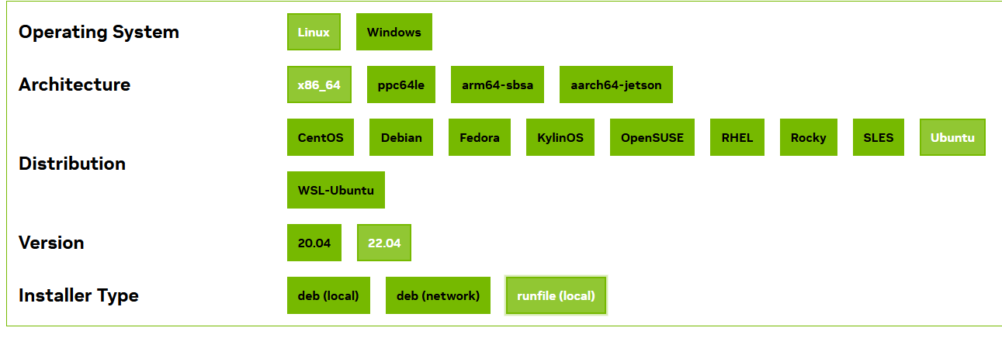
Configuration method 2 vmware esxi Pass-through GPU + unbutu +Run ai module
Step 3: Install CUDA Toolkit (Without Driver Installation)
wget https://developer.download.nvidia.com/compute/cuda/12.4.0/local_installers/cuda_12.4.0_550.54.14_linux.run
sudo sh cuda_12.4.0_550.54.14_linux.run

Slide 12
Configuration method 2 vmware esxi Pass-through GPU + unbutu +Run ai module
Step 4: Install Anaconda-python 3.10
chmod +x Anaconda3-2024.10-1-Linux-x86_64.sh
./Anaconda3-2024.10-1-Linux-x86_64.sh
conda create -n myenv python=3.10 -y
conda activate myenv
# Install vLLM with CUDA 12.1.
pip install vllm
Run ai module
python3.10 -m vllm.entrypoints.openai.api_server --model /home/ai/Llama-3___2-Instruct --enforce-eager --tensor-parallel-size 1 --trust-remote-code --dtype float16 --gpu-memory-utilization 0.95 --max-model-len 10000

